Slide 1
Working With Git

Slide 2
Overview
Recap
Github example
Communicating
Workflows
Practical

Slide 3
Recap:
Quick Quiz
Notes:
What does HTML stand for?
What does it do?
How do we add style to HTML?
How far have we got through freeCodeCamp?
What other learning platforms are people using?

Slide 4

Question 1
What's the git command that downloads your repository from GitHub to your computer?
git push
git fork
git clone
git commit

Slide 5
Question 1
What's the git command that downloads your repository from GitHub to your computer?
git push
git fork
git clone
git commit

Slide 6
Question 2
What's the git command that uploads your changes and code back to GitHub?
git push
git add
git upload
git status

Slide 7
Question 2
What's the git command that uploads your changes and code back to GitHub?
git push
git add
git upload
git status

Slide 8
Question 3
How do you check the state of your local git repository since your last commit?
git check
git status
git commit
git diff

Slide 9
Question 3
How do you check the state of your local git repository since your last commit?
git check
git status
git commit
git diff

Slide 10
Question 4
What's a shortcut to staging all the changes you have?
git commit add .
git commit .
git add .
git push -am "Message"

Slide 11
Question 4
What's a shortcut to staging all the changes you have?
git commit add .
git commit .
git add .
git push -am "Message"

Slide 12
Branch and Commit
Branch
Commit
Notes:
Ask the group to explain what these mean

Slide 13
Branch and Commit
Branch
When we start a new piece of work - a new feature or issue we’ll create a branch.
A branch indicates a specific point where we started doing that work
When we have finished the work we can merge the branch back into the master code.
Commit
Whenever we change something in the code we commit - this is like a ‘save game’ a point in history we can get back to if needs be - or that will help us find out when or where something went wrong.
Commit as often as possible and always write a coherent accurate message to remind yourself and other devs what you did.

Slide 14
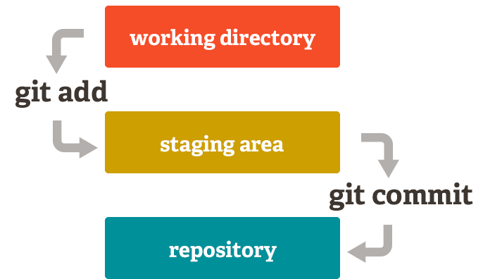

Slide 15
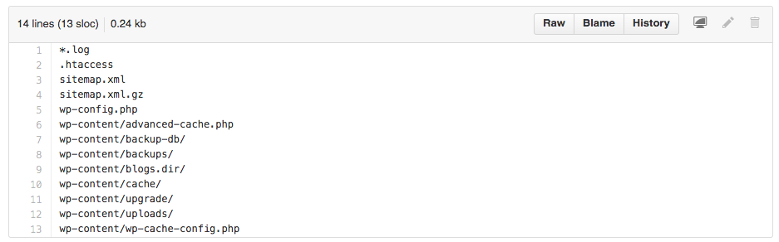
.gitignore

Slide 16
What sort of files might we expect to be ignored - why?

Slide 17
Pull Request

Slide 18
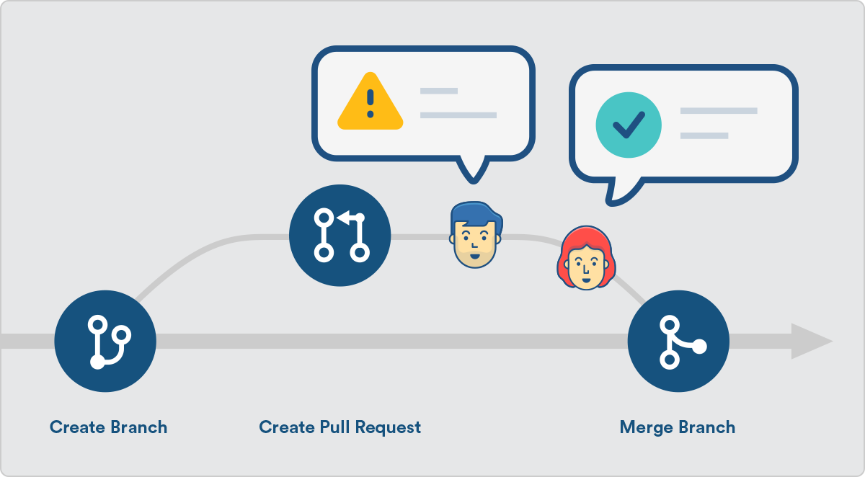
Pull Request

Slide 19
Workflows

Slide 20
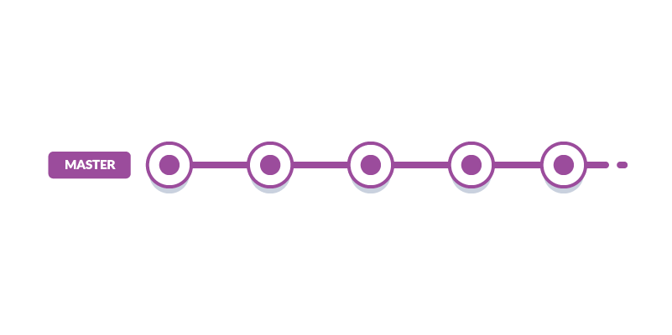
Basic

Slide 21
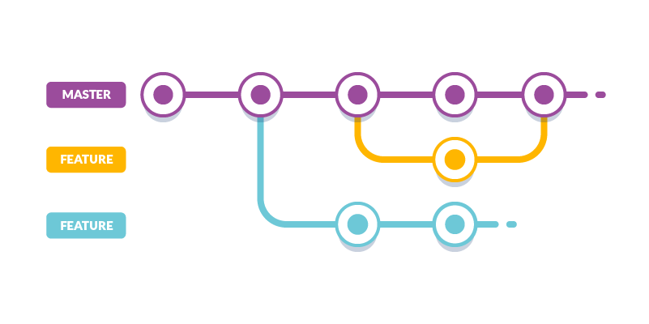
Feature Branch

Slide 22
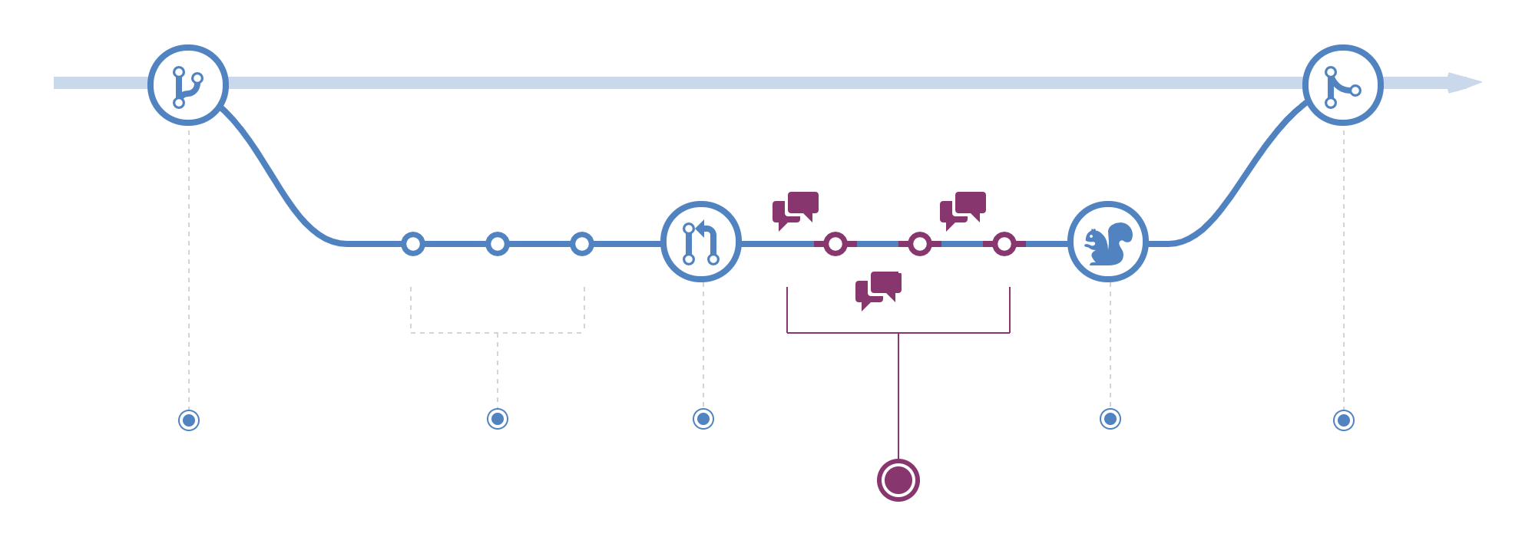
GitHub Flow

Slide 23
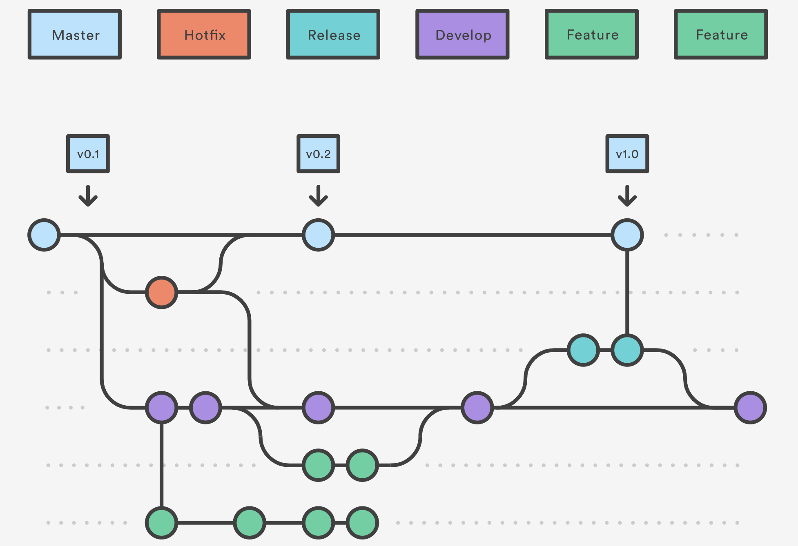
GitFlow

Slide 24
Commit message

Slide 25
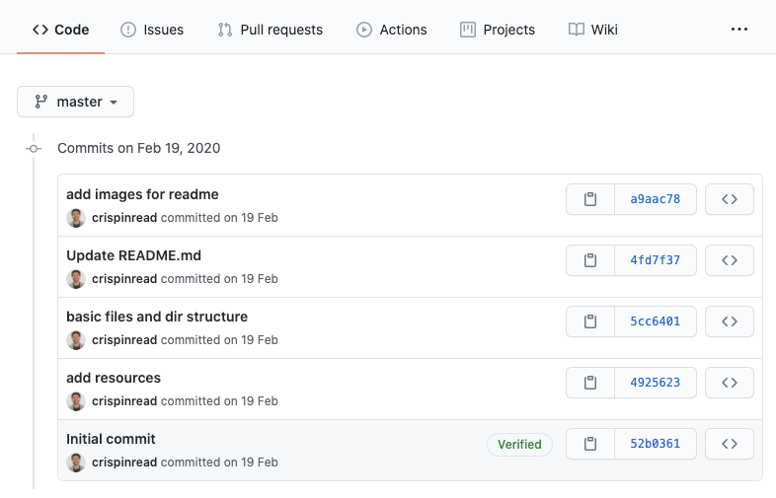
They can tell the story so far...
https://github.com/thecodersguilduk/wda-feeding-britain/commits/master
Notes:
You can see what the developer was thinking - how they

Slide 26
Some Guidance

Slide 27
DO
Write the summary line and description of what you have done in the imperative mood, that is as if you were commanding someone. Start the line with "Fix", "Add", "Change" instead of "Fixed", "Added", "Changed".
Always leave the second line blank.
Line break the commit message (to make the commit message readable without having to scroll horizontally in gitk).

Slide 28
Don’t
end the summary line with a period - it's a title and titles don't end with a period.

Slide 29
Tip
If it seems difficult to summarize what your commit does, it may be because it includes several logical changes or bug fixes.
Better split up into several commits using git add -p.

Slide 30


Slide 31
Group Task
Create the page outlined in these source files. We are not looking for a finished page but let’s see if we can get the main HTML elements up there
Flesh out the HTML in sections
Add logo to header
Add Nav
Add hero section
...
Build a page on GitHub
Deploy to Netlify

Slide 32
How did we do?

Slide 33
Takeaway Tasks 4.3.1
Create a git Cheat sheet in HTML
Complete Fracz Git Exercises
Add evidence of these to your blog

Slide 34
Resources
Atlassian - Pull Request Tutorial
Atlassian - Comparing Git Workflows
freeCodeCamp - Writing Good Commit Messages
Chris Beams - How to write a commit msg
Fracz Git Exercises

Slide 35
Questions?

